Slide 1
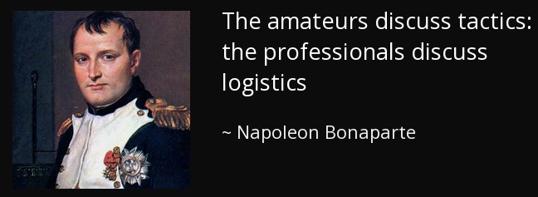
LSN 27
Last Class:
WPR #3
Today’s Class:
Sustainment, Command & Signal
Next Class:
WPR #4 OPORD Briefs until 02 DEC
LSN 27 | LSN 28 | LSN 29 | LSN 30
Sustainment Command & Signal | Drop ISO WPR #4 Platoon OPORD Briefs | Drop ISO WPR #4 Platoon OPORD Briefs | “Why We Fight” Course LOA

Slide 2
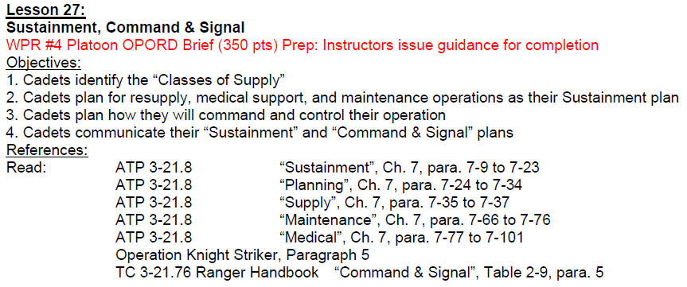
Today’s Target List

Slide 3
Learning Guide
Supply
Sustainment:
1-3-5-M-M as a memory tool
Planning factors
Medical
Maintenance
Resupply procedures
Application to a platoon attack
Command
Signal

Slide 4
OPORD

Slide 5

Phase Line:
Supply

Slide 6

Classes of Supply
K
Class | Description | Example
I | Food, rations, water
II | Clothing
III | Petroleum, oil, and lubricants
IV | Fortification & barrier materials
V | Ammunition
VI | Personal items
VII | Major end items
VIII | Medical materiel and supplies
IX | Repair parts
X | Miscellaneous supplies
MREs, water cans/buffalo
OCPs, NBC overgarments
Fuel, LSA, CLP
Lumber, sand bags, C-wire
Small arms, grenades, mines, fuzes, detonators
PX items, soap
Vehicles, major weapons systems
Medicine, surgical instruments, blood, preventative care
Items for maintenance support, batteries, repair kits
Anything that doesn’t fall in any of the classes above

Slide 7
Classes of Supply
K
Class | Description | Example
I | Food, rations, water
II | Clothing
III | Petroleum, oil, and lubricants
IV | Fortification & barrier materials
V | Ammunition
VI | Personal items
VII | Major end items
VIII | Medical materiel and supplies
IX | Repair parts
X | Miscellaneous supplies
MREs, water cans/buffalo
OCPs, NBC overgarments
Fuel, LSA, CLP
Lumber, sand bags, C-wire
Small arms, grenades, mines, fuzes, detonators
PX items, soap
Vehicles, major weapons systems
Medicine, surgical instruments, blood, preventative care
Items for maintenance support, batteries, repair kits
Anything that doesn’t fall in any of the classes above

Slide 8
Phase Line:
Sustainment

Slide 9
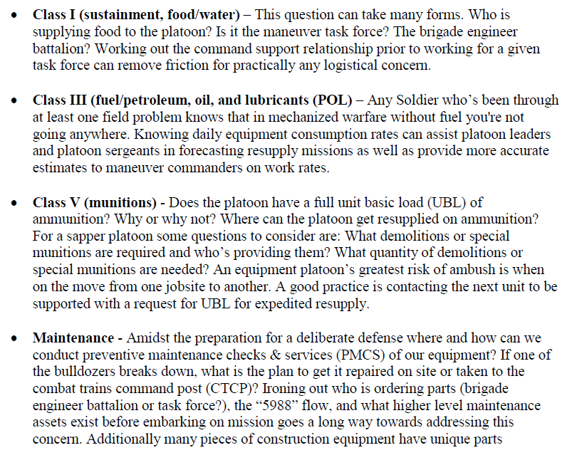
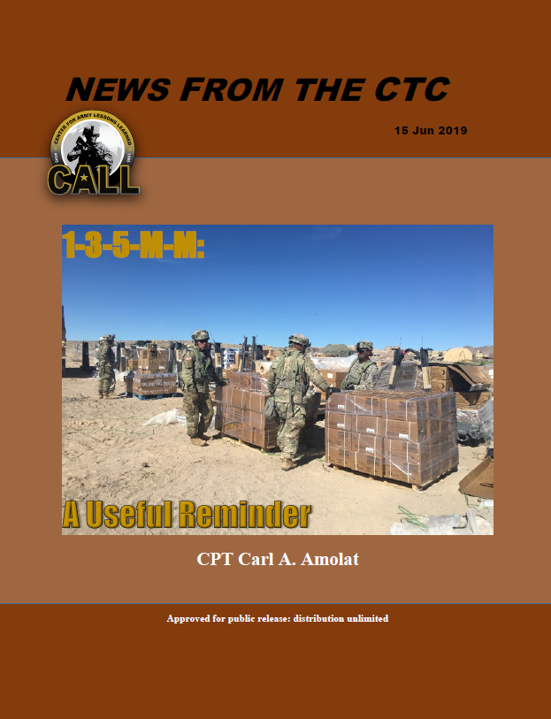
Sustainment Considerations
“1-3-5-M-M”

Slide 10
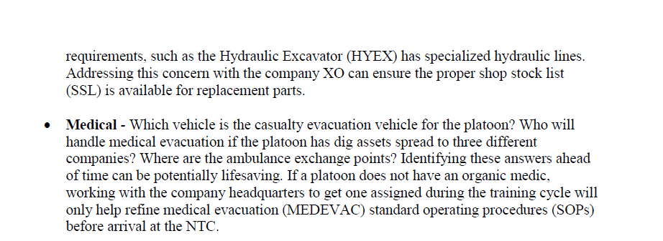
Sustainment Considerations
“1-3-5-M-M”

Slide 11
Sustainment Considerations
“1-3-5-M-M”

Slide 12
Sustainment Planning
Quantities. In what quantities will this support be required?
Will emergency resupply be required during the battle?
Does this operation require pre-stocked supplies?
Threat. What are the composition, disposition, and capabilities of the expected enemy threat? How will these affect sustainment plan during execution?
Where and when will the expected contact occur?
What are the platoon’s expected casualties and vehicle losses based on the nature and location of expected contact?
What impact will the enemy’s special weapons capabilities (such as CBRN) have on the battle and on expected sustainment requirements?
How many EPWs are expected, and where?

Slide 13
Sustainment Planning
Terrain and Weather. How will terrain and weather affect sustainment plan during the battle?
What are the platoon’s vehicle and casualty evacuation routes?
What ground will provide the best security for maintenance and CCPs?
What are the company’s dirty routes for evacuating contaminated personnel, vehicles, and equipment?
Time and location. When and where will the platoon need sustainment?
Based on the nature and location of expected contact, what are the best sites for the CCP?
Where will the EPW collection points be located?
Requirements. Which section has priority for emergency resupply?
Which section has priority for emergency Class III resupply?
Risk. Will lulls in the battle permit support elements to conduct resupply operations in relative safety?

Slide 14
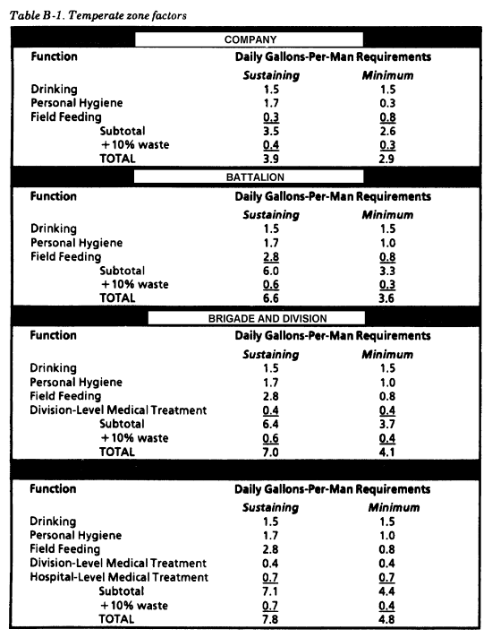
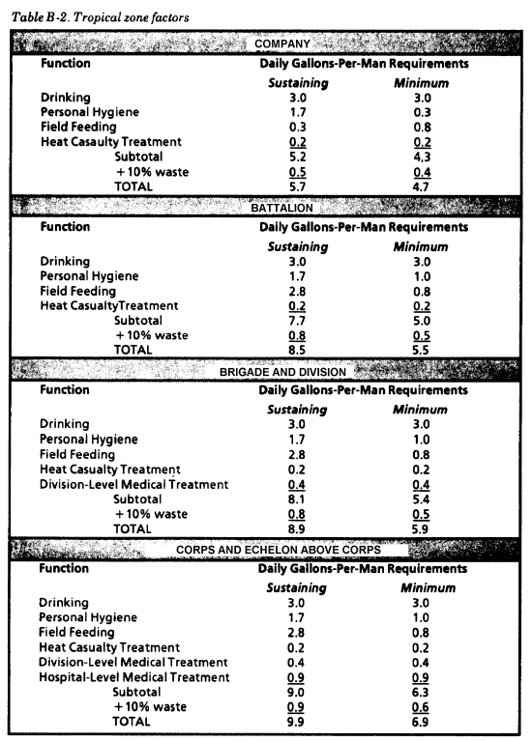
Water Consumption

Slide 15
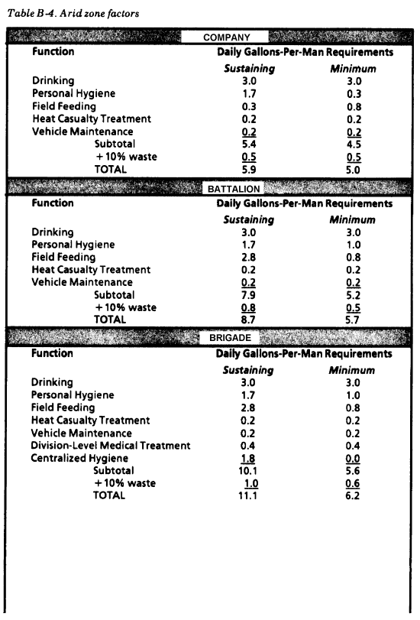
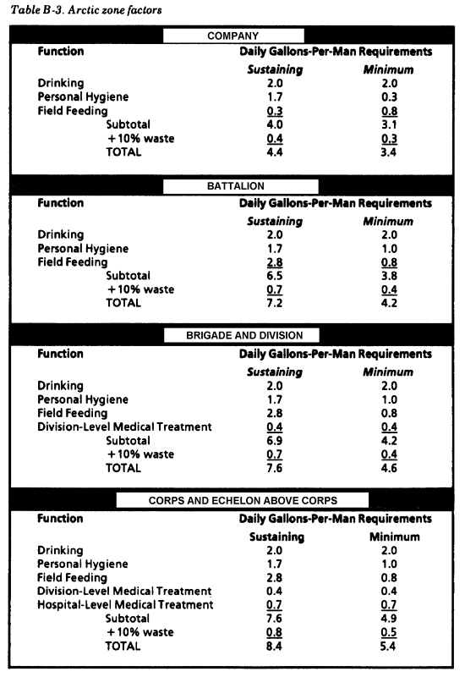
Water Consumption

Slide 16
Phase Line:
Medical

Slide 17
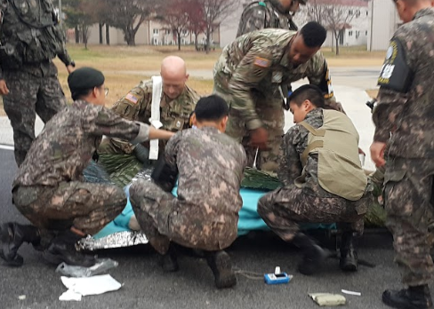
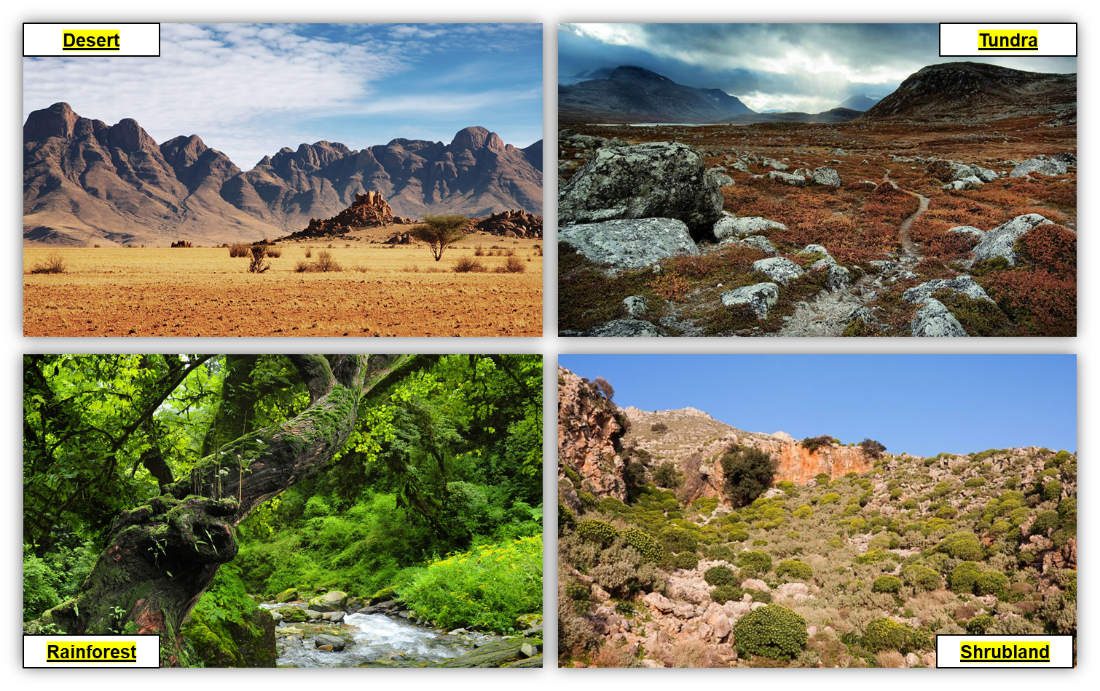
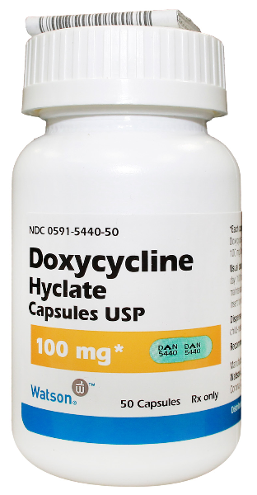
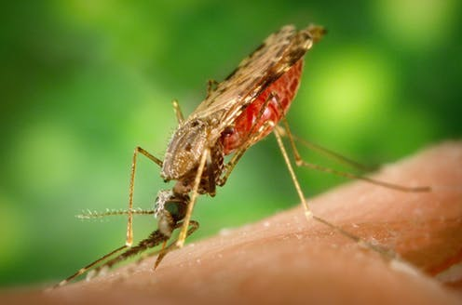
Sustainment Considerations
Medical Support
Levels of treatment: Role 1 and beyond
CASEVAC vs. MEDEVAC?
Casualty collection points (CCP) (use Terrain Analysis)
Prevention

Slide 18
Phase Line:
Maintenance

Slide 19
Maintenance Operations
K
Field Maintenance
Preventative maintenance, checks, and services (PMCS)
Forward maintenance teams
“You break it, you fix it.”
What’s going to break, how are you going to fix it with what parts, and when
Sustainment Maintenance
“You break it, but you can’t fix it.”
Someone else has to fix it for you.
Was this an accident or negligence? Discipline to prevent both!
MS200

Slide 20
Phase Line:
Resupply

Slide 21
Resupply Operations
K
Routine
“1-3-5-M-M” as a tool, but all classes of supply as required
Logistics Package (LOGPAC) convoy to Logistics Release Point (LRP)
Emergency
Pre-stock
MS200

Slide 22
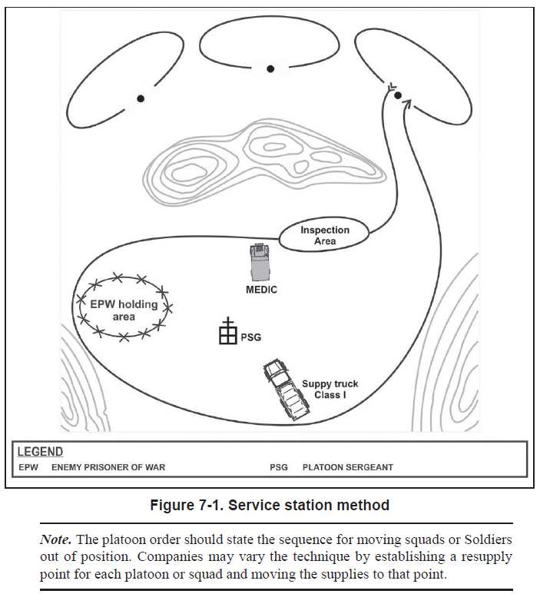
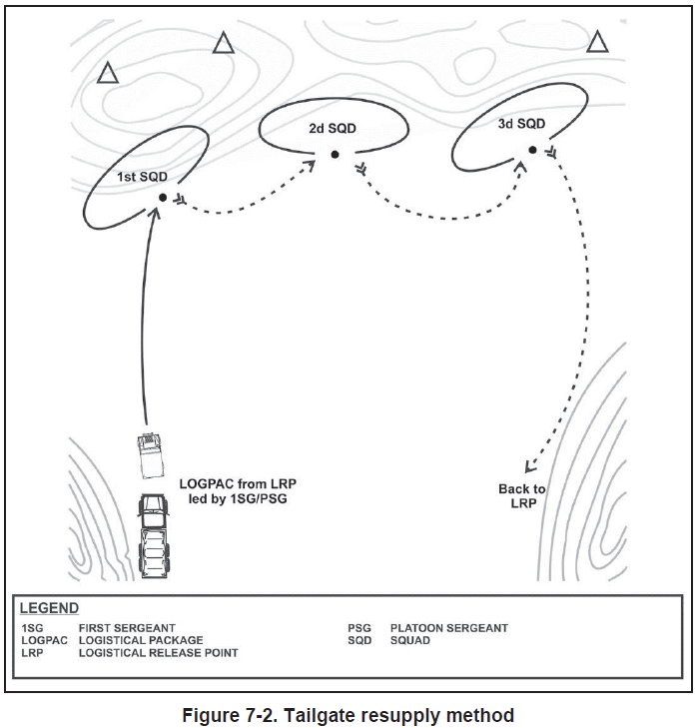
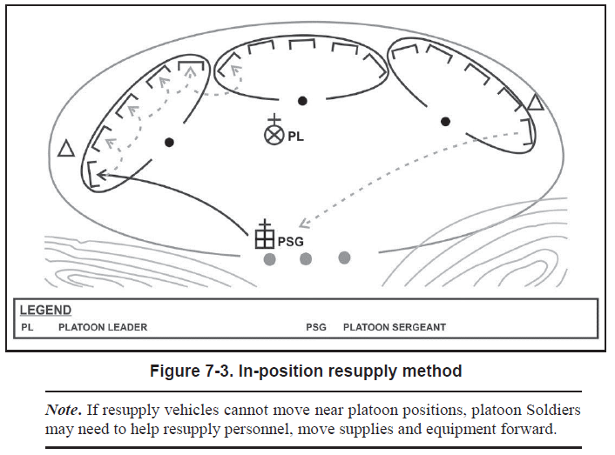
Resupply Methods
Service Station
Tailgate
In-position
What are advantages & disadvantages?
What makes the most sense for your mission?

Slide 23

Operational Environment
“West Point”

Slide 24




Planning Considerations
Desert
Tundra
What might some of your sustainment planning considerations be in a different biome?
Rainforest
Shrubland

Slide 25
Phases of Operation
**Briefed while using a Map and Sandtable**
Ph 1
Ph 2
Ph 3
Ph 4
Ph 5
Planning &
Prep
Movement
Isolate the OBJ
Actions on OBJ
Consolidate
-Prep for CATK
and/or Exfil
AA
ORP
OBJ
Planning
Timeline
Priority of Rehearsals
Priority of PCC/PCI’s
Special Equipment/Ammo Allocations
Coordination among Units & Attachments
Tasks to Subordinate Units
Eny Activity at this Time
OOM
Distance
Direction
Formation
Technique
Speed
Checkpoints
Actions at Halts
Occupation of ORP
Actions on Contact
DFCM’s/WCS
IDF(TTLODAC)
MEDEVAC/CCP’s
Eny Activity at this Time
Adjacent Units/Reports
Leader’s Recon Purpose
GOTWA
Actions on Contact
DFCM’s/WCS
Type or Form of Contact Expected (8)
Engagement Criteria
Emplacement & Occupation of Security, SBF and Assault Pos
Location of Key Leaders
Eny Activity at this Time
MEDEVAC/CCP’s
Adjacent Units/Reports
Initiate Fires (Trigger)
Distribution of Fires
Engagement Priorities
DFCM’s/WCS
IDF(TTLODAC)
Assault/Breach Plan
Maneuver Technique
Decisive Point
Clearing OBJ
PACE Plan
Location of Key Leaders
Eny Activity at this Time
Special Teams: EPW, Aid and Litter,
Adjacent Units/Reports
Hasty Defense Security Plan
Sectors of Fire
DFCM’s/WCS
IDF(TTLODAC)
PACE Plan
Eny Activity
Location of Key Leaders
MEDEVAC
Adjacent Units/
Key Reports
Withdrawal Plan or transition to Deliberate Defense

Slide 26
Sustainment
Class | Material | Quantity | Planning Considerations
I | Food, rations, water
II | Clothing
III | Petroleum, oil, and lubricants
IV | Fortification & barrier materials
V | Ammunition
VI | Personal items
VII | Major end items
VIII | Medical materiel and supplies
IX | Repair parts
X | Miscellaneous supplies

Slide 27
Sustainment
Phase | I | II | III | IV | V
Resupply locations and procedure
Emergency resupply locations and procedure
Location of CCPs
Location of AXPs
Location of maintenance operations
EPW handling procedures

Slide 28
Phase Line:
Command & Signal

Slide 29
Command & Signal
States where mission command facilities and key leaders are located during the operation.
Command. Include the following information: Location of commander or patrol leader: state where the commander intends to be during the operation, by phase if the operation is phased. Succession of command: state the succession of command, if not covered in the unit SOP.
Control. Include the following information:
Command posts: describe the employment of CPs, including the location of each CP and its time of opening and closing, as appropriate. Typically, at platoon level the only reference to command posts is the company CP.
Reports: list reports not covered in SOPs.
Signal: Describe the concept of signal support.
Identify methods of communication by priority.
Describe pyrotechnics and signals, to include arm and hand signals
Give code words such as OPSKEDs
Give challenge and password (use behind friendly lines).
Give number combination (use forward of friendly lines).
Give running password.
Give recognition signals (near & far and day & night).
Ranger Handbook TC 3-21.76

Slide 30
Command & Signal
Succession of Command:
Key leader locations
Phase | I | II | III | IV | V
PL
PSG
 | Signal (Day) | Signal (Night)
Primary
Alternate
Continency
Emergency
Number combo:___ | Method: | Method:
Radio frequencies:
Special signals:
Challenge:
Password:
“Are there any questions? Confirmation Brief to me will be at ___”

Slide 31
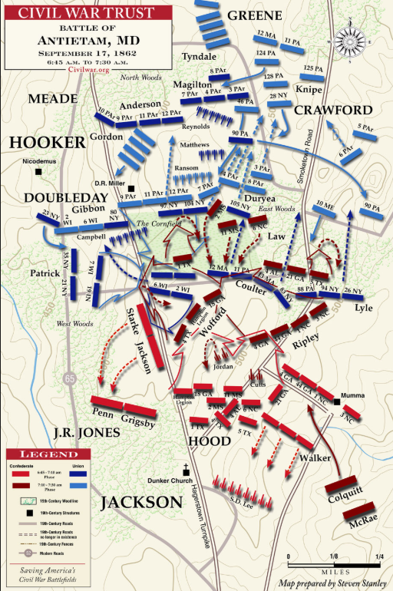
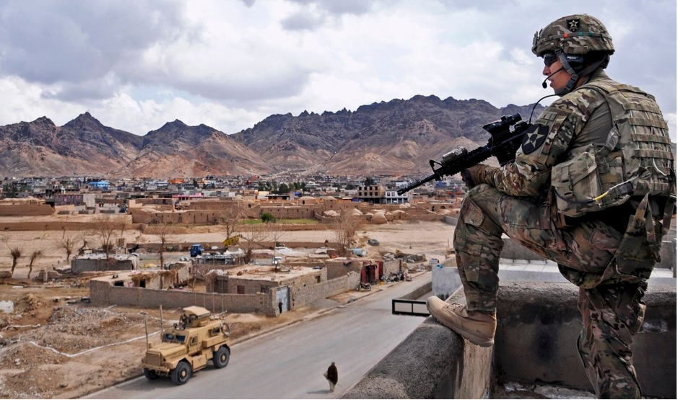
Command
Where can you best command and control your SL’s?
What position provides the best situational awareness? Does it allow for reaction / flexibility?
Where can your PSG be best employed for this operation? Your FO? Your Medic?
Could these factors change throughout phases of the operation?
PL – Decisive Point. PSG – Friction Point.

Slide 32
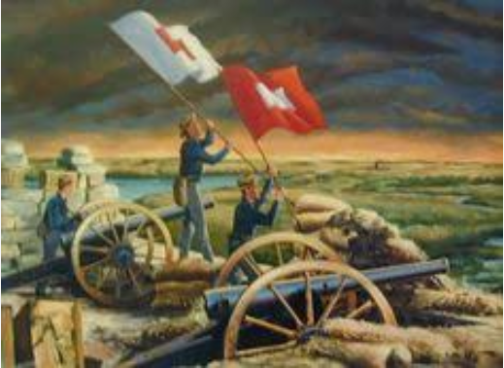
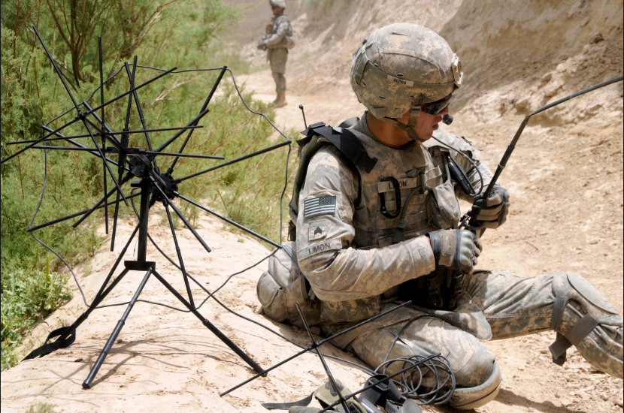

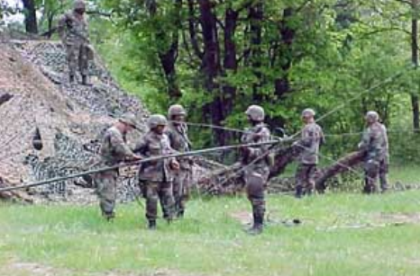
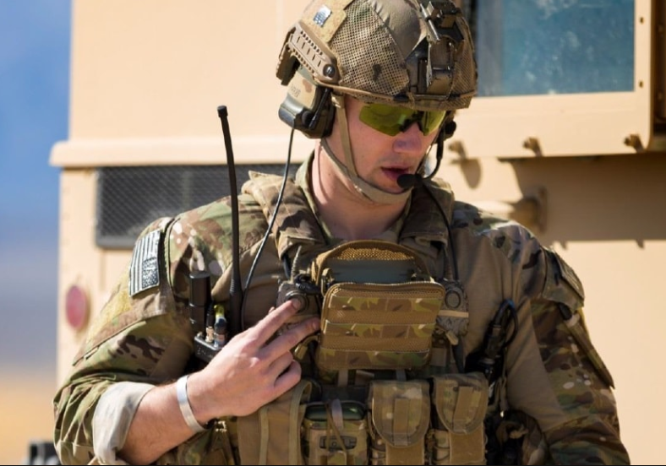
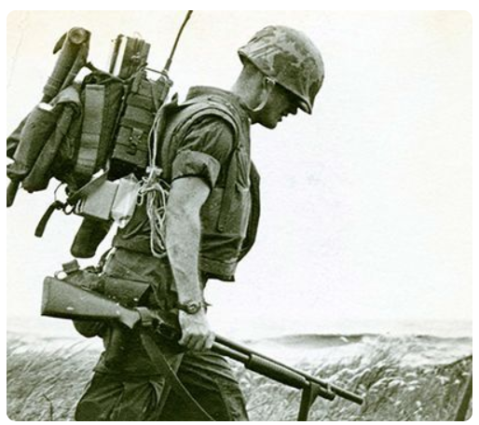
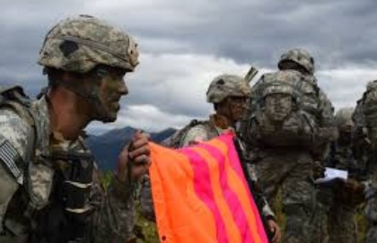
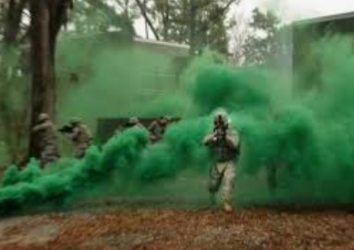
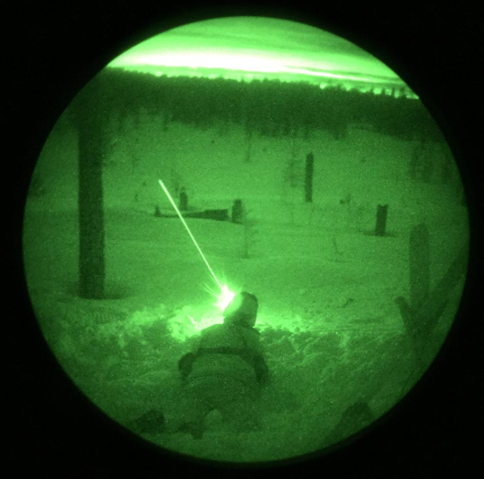
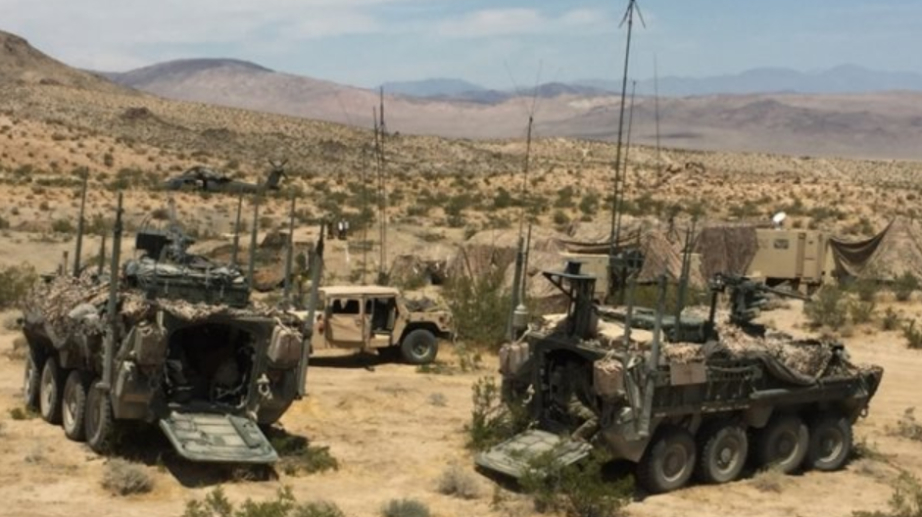
Signal
Radio Communication
What all do I have available to communicate at the PLT level?
How should I communicate Direct Fires? Indirect Fires?
How can I communicate to SL’s? PSG? My Commander?
My FSO?
Visual Communication
Method of Marking
How can you mark friendly positions?
How can you mark enemy positions?
Do these differ from day to night? Weather? Air to Ground?

Slide 33
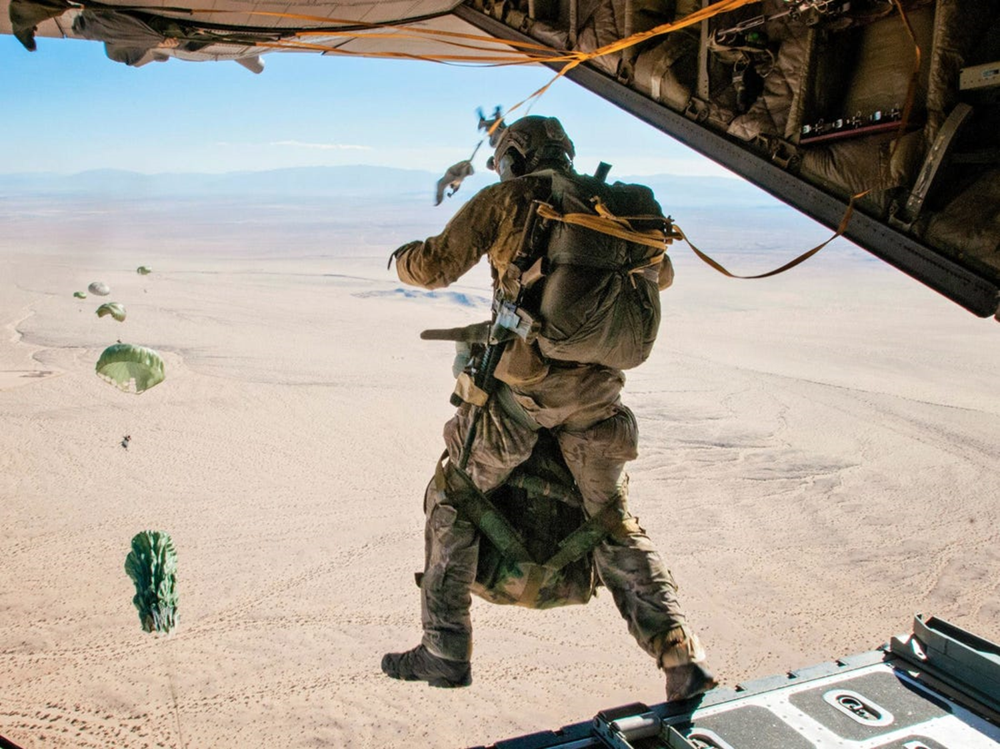
YOU
Final OPORD
The end of the course
PDR Counselings

Slide 34
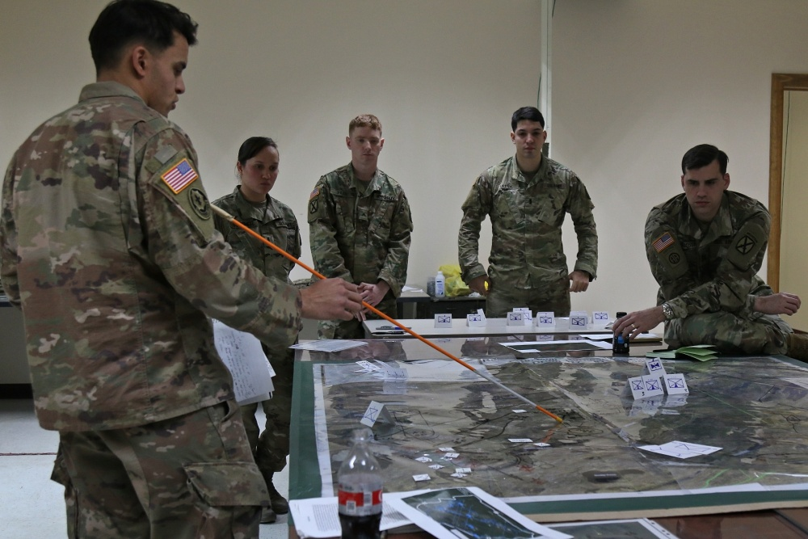
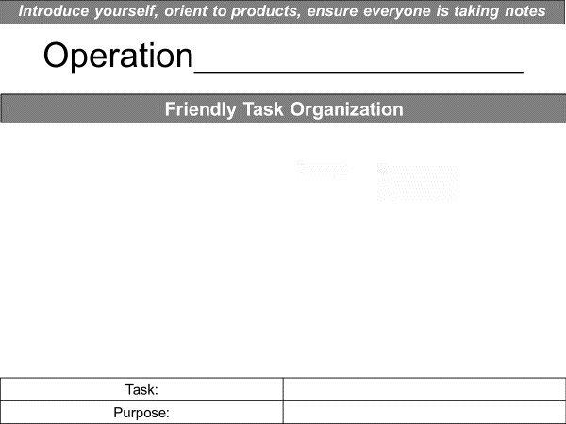
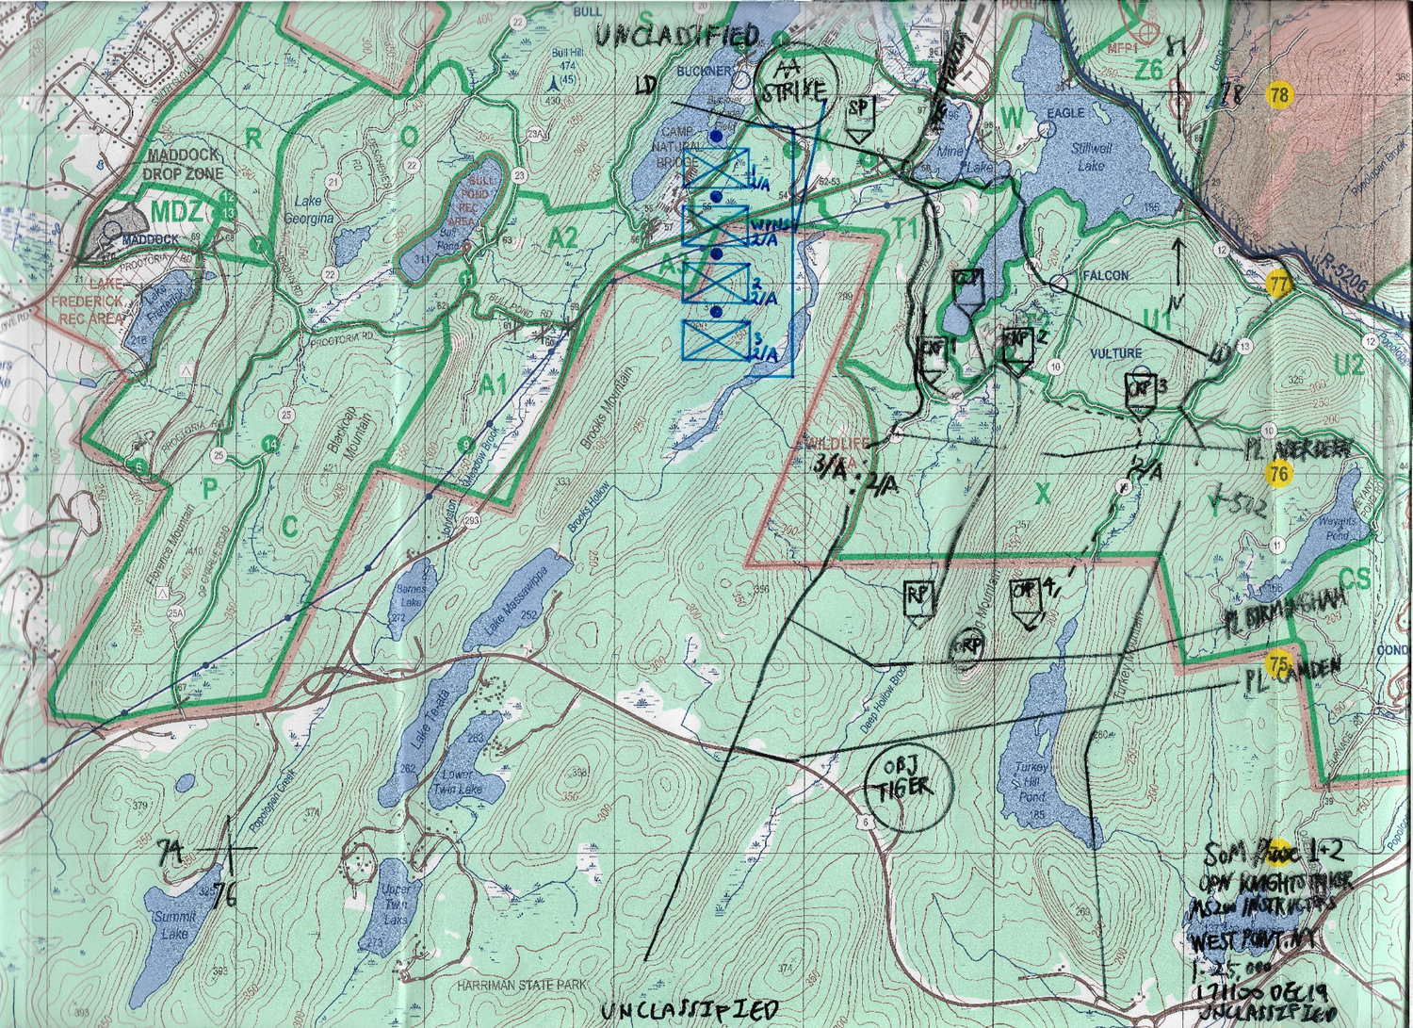
WPR #4
Sign-up no later than Friday, 20 1700 NOV.
Briefing window from Monday, 23 NOV to Wednesday, 02 DEC (40 minutes)
“OPORD Trident Justice” will release on Tuesday, 17 NOV following WPR #3.

Slide 35
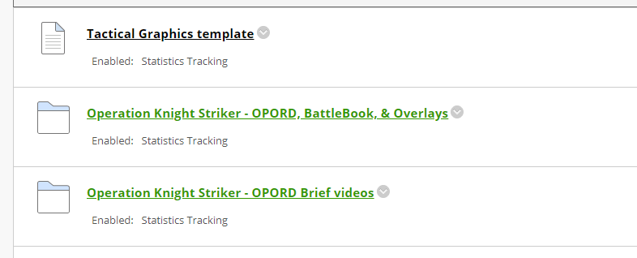
Knight Striker examples

Slide 36
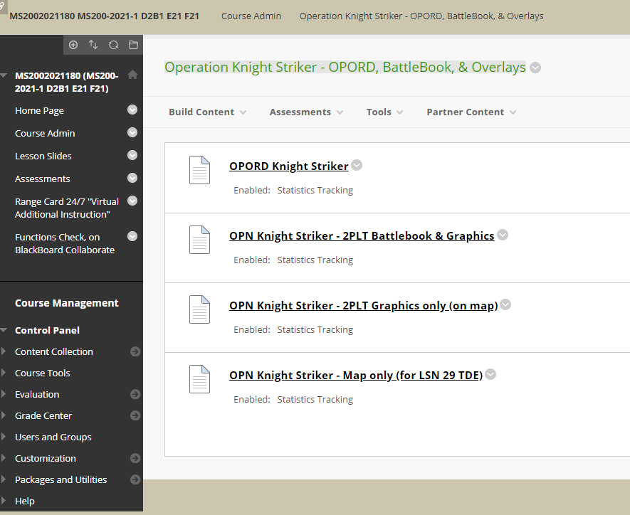
Knight Striker
example products

Slide 37
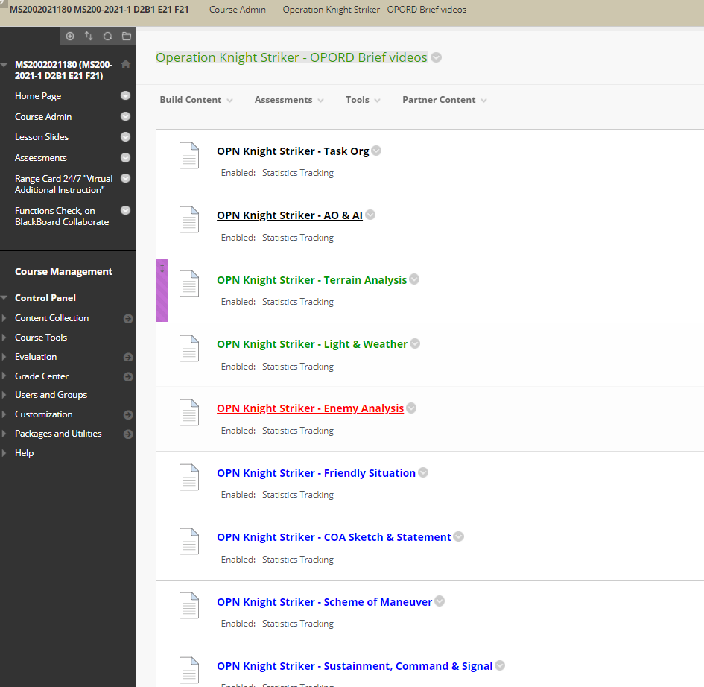
Knight Striker videos

Slide 38
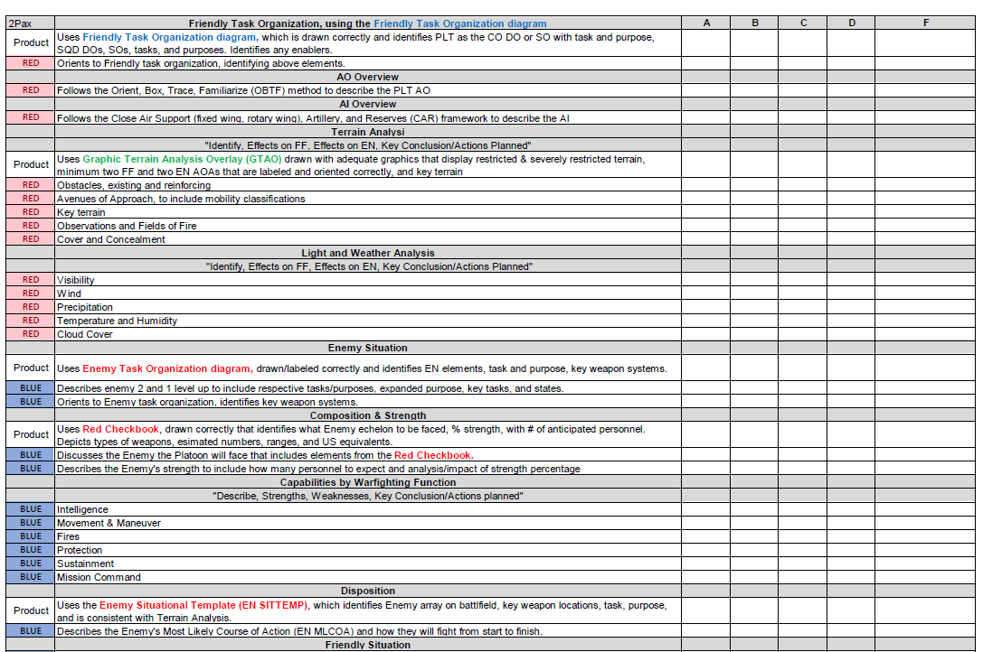
Sanitized Rubric
+ Use your Battle Book!

Slide 39
WPR #3
Who is briefing Monday?
I will grade WPR #3 thru this weekend
Will be available for pick-up from my office at WH5117 starting Monday morning
Grades in CIS: I will input scores AFTER you come pick it up.
Until you come pick it up, you will have a grade of “0%, F”

